Slide 1
CS7/8745 : Machine Learning Instructor: Salim Sazzed Department of Computer Science University of Memphis

Slide 2
Recap

Slide 3
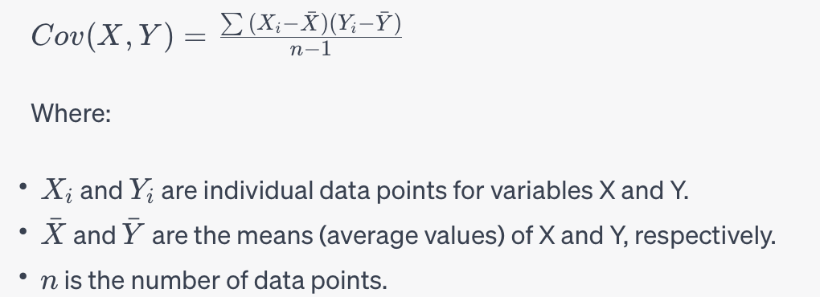
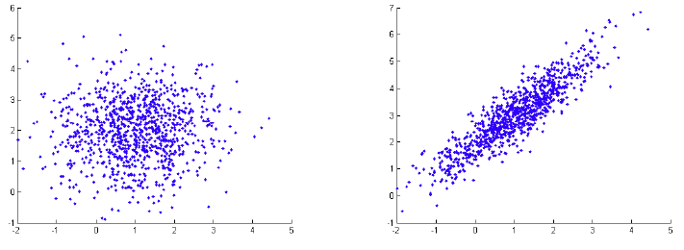
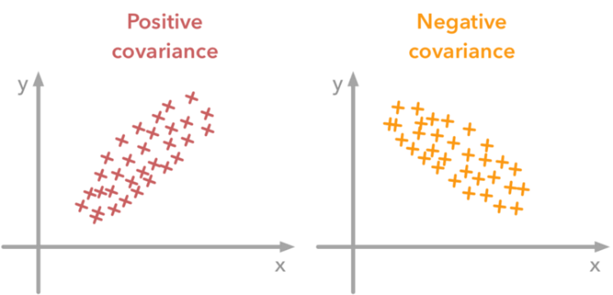






Let $X=\left[x_{1}, x_{2},…x_{n}\right]$
Let Y $=\left[y_{1}, y_{2},…y_{n}\right]$
Covariance quantifies the degree to which two random variables change together.
$$Y$$
No covariance
$$Y$$
High covariance
$$X$$
$$X$$

Slide 4
Given two variables, X = [2, 4, 6, 8, 10] and Y = [1, 3, 5, 7, 9], calculate the covariance between X and Y.
1. Compute mean of X and Y
2. Use the following formula-

Slide 5
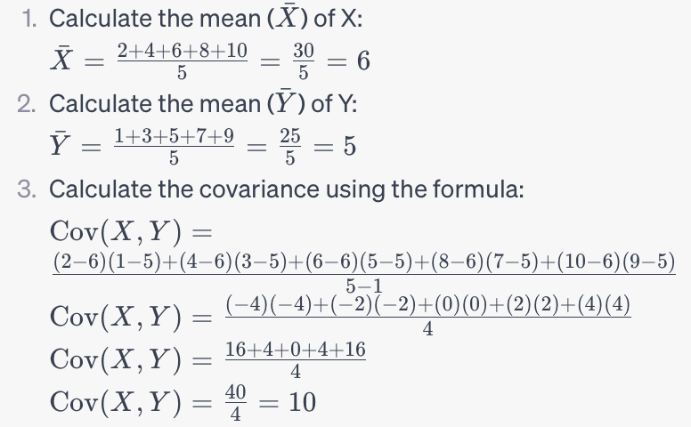

Slide 6
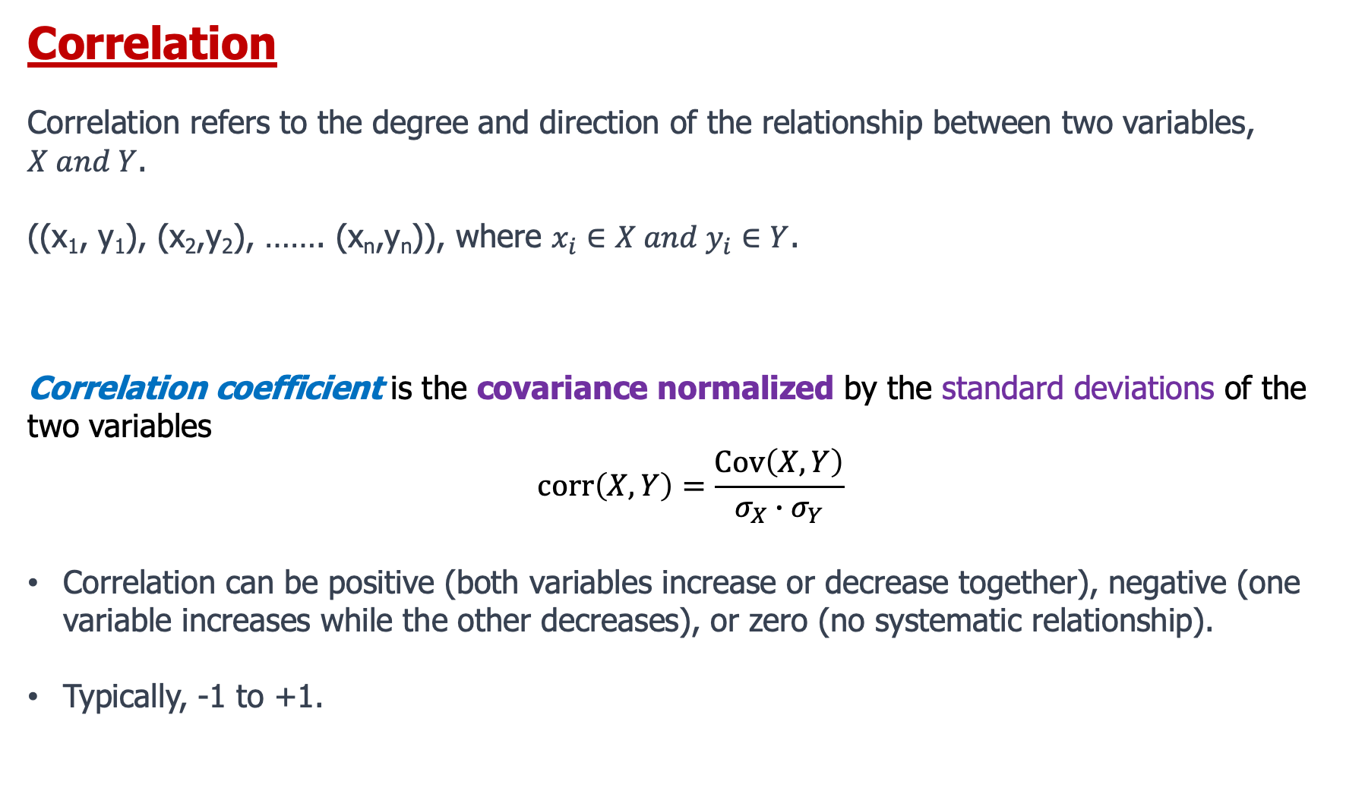
Correlation
Correlation refers to the degree and direction of the relationship between two variables, $X and Y$.
((x₁, y₁), (x₂,y₂), ……. (x_{n},y_{n})), where $x_{i}∈X and y_{i}∈Y$.
Correlation coefficient is the covariance normalized by the standard deviations of the two variables
$$corr\left(X,Y\right)=\frac{Cov\left(X,Y\right)}{σ_{X}∙σ_{Y}}$$
Correlation can be positive (both variables increase or decrease together), negative (one variable increases while the other decreases), or zero (no systematic relationship).
Typically, -1 to +1.

Slide 7
A
B
C
D
E
F

Slide 8
Data for machine learning

Slide 9
Data Modalities
In machine learning, "modalities" refer to different types or modes of data, each representing a distinct aspect of information.

Slide 10
Text Modality
Text data includes natural language text in the form of documents, articles, reviews, and more.
Documents:
Social Media Posts:
Web Pages:
Emails:
Reviews:
News Articles:
Medical Records:
Legal Documents:
Chat Logs
Natural Language Processing (NLP) techniques are used to process and analyze text data.

Slide 11
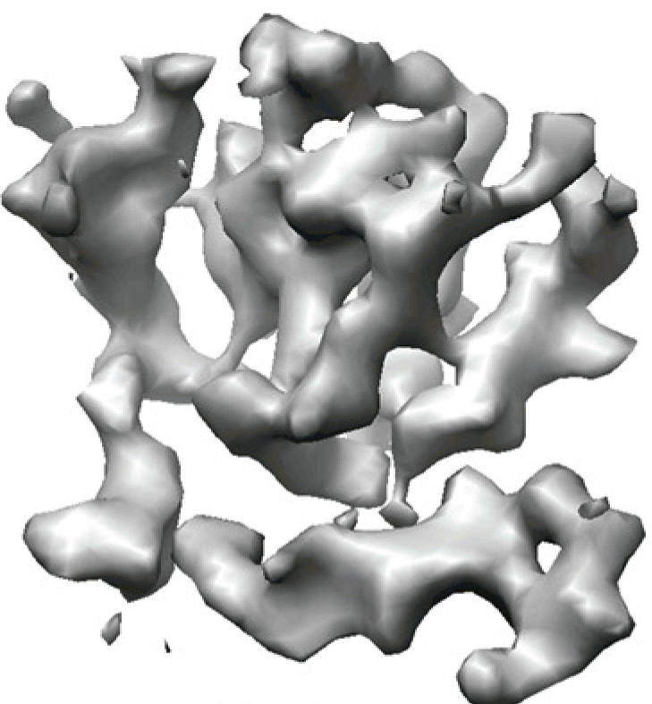
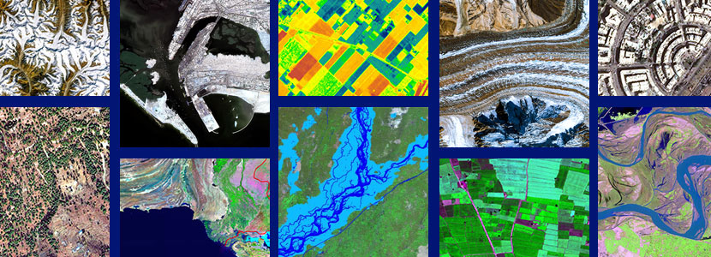
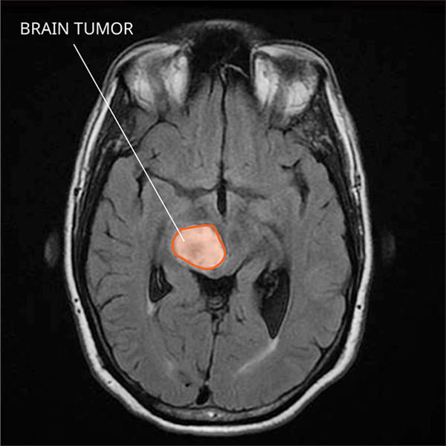
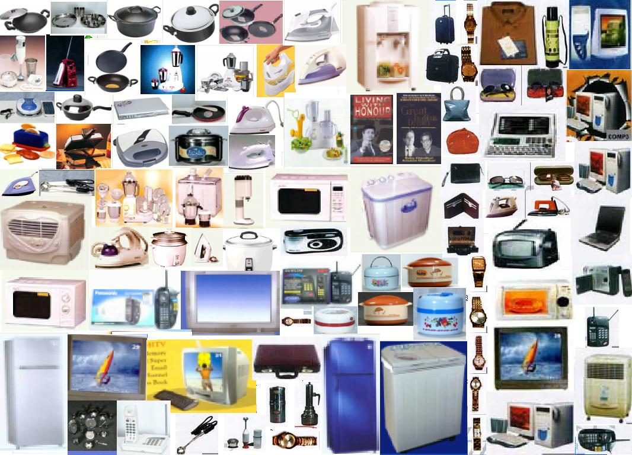
Image Modality
Biological data
Remote sensing data
Image data consists of visual information, typically in the form of 2D or 3D arrays of pixels.
Convolutional Neural Networks (CNNs) are commonly used to analyze and extract features from image data.
Ecommerce product data
medical imaging data

Slide 12
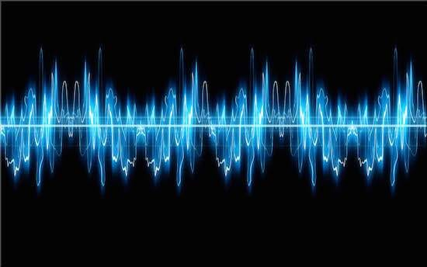
Audio/Speech Modality
Audio data represents sound information, often recorded as waveforms.
Techniques such as spectrogram analysis and audio processing are used for feature extraction and analysis.

Slide 13
Time Series Modality:
Time series data is collected or recorded over time at regular intervals.
Each data point in a time series is associated with a specific timestamp or time period, making it a sequence of data points ordered chronologically.
Time series data is widely used in various fields, including finance, economics, environmental science, engineering, and more, to analyze and make predictions based on temporal patterns and trends.
Financial Forecasting: Predicting stock prices, currency exchange rates, and economic indicators.
Demand Forecasting: Forecasting product demand for inventory management.
Environmental Monitoring: Analyzing temperature, humidity, pollution levels, and weather patterns over time.
Energy Consumption: Modeling and predicting electricity and energy usage.
Healthcare: Monitoring patient vital signs and disease progression.
Industrial Processes: Monitoring and optimizing manufacturing processes.
Traffic and Transportation:

